Slide 1



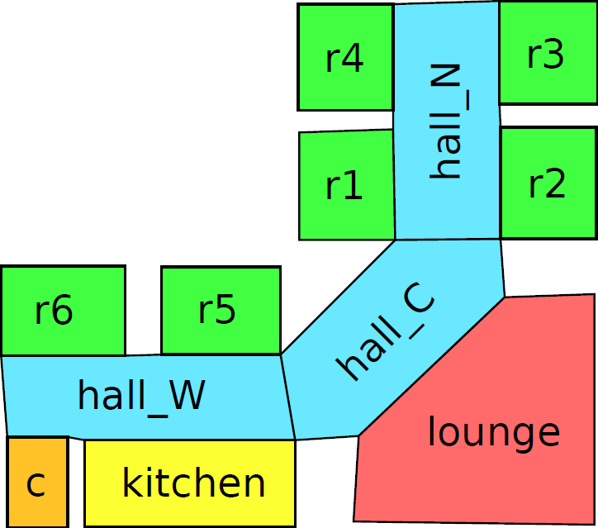
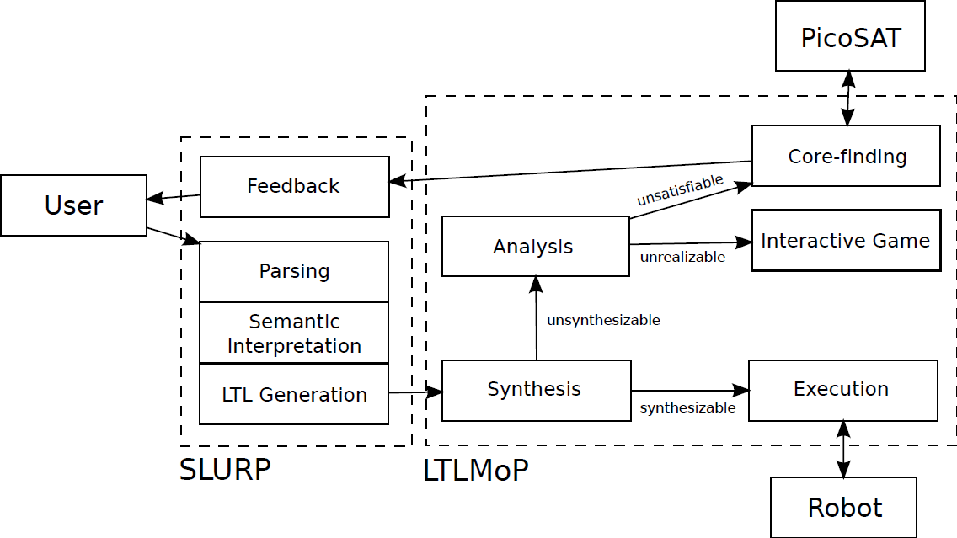
Sorry Dave, I’m Afraid I Can’t Do That: Explaining Unachievable Robot Tasks Using Natural Language
Vasumathi Raman*, Constantine Lignos†, Cameron Finucane*, Kenton C.T. Lee†, Mitch Marcus† and Hadas Kress-Gazit*
*Cornell University (vraman@cs.cornell.edu, {cpf37, hadaskg}@cornell.edu)
†University of Pennsylvania ({lignos@cis, kentonl@seas, mitch@cis} .upenn.edu)
Motivation
Example: Hospital Assistant Robot
Automatically generate provably correct control from high-level specifications for robots from natural language instructions. Explain the cause of failure for unachievable specifications.
public rooms
patient rooms
Overview
Scenario 1:
Start in the closet. Carry meals from the kitchen to all patient rooms. Don’t go into any public rooms.
Scenario 2:
Follow me. Avoid the kitchen

Slide 2
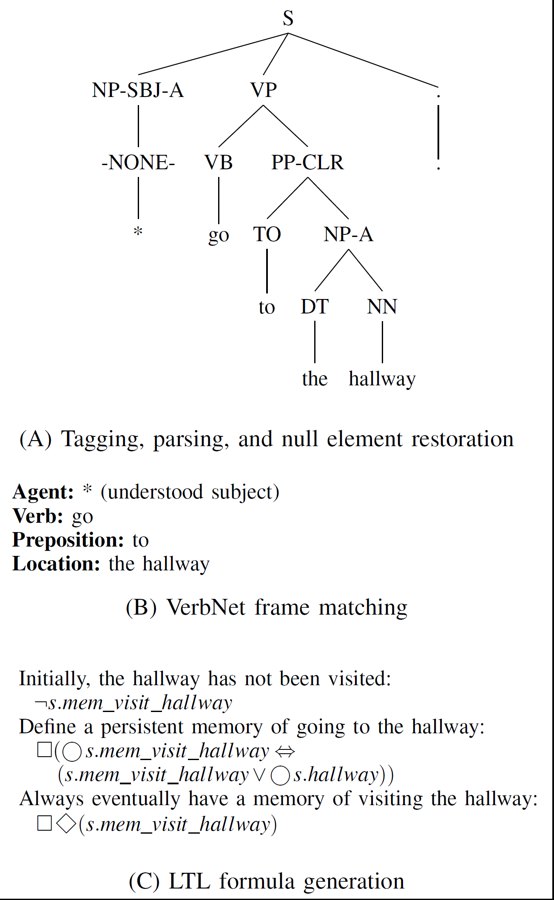
Sorry Dave, I’m Afraid I Can’t Do That: Explaining Unachievable Robot Tasks Using Natural Language
Vasumathi Raman, Constantine Lignos, Cameron Finucane, Kenton C.T. Lee, Mitch Marcus and Hadas Kress-Gazit
Automatically generate provably correct control from high-level specifications for robots from natural language instructions. Explain the cause of failure for unachievable specifications.
Situated Language Understanding Robot Platform (SLURP)
Parsing
Part-of-speech tagging using MXPOST ¹
Bikel parser ² + null element restoration of Gabbard et al. ³
¹ A. Ratnaparkhi et al. A maximum entropy model for part-of-speech tagging. EMNLP, volume 1, pages 133–142, 1996.
² D.M. Bikel. Intricacies of Collins’ parsing model. Computational Linguistics, 30(4):479–511, 2004.
³ R. Gabbard, M. Marcus, and S. Kulick. Fully parsing the Penn Treebank. HLT-NAACL, pages 184–191, 2006.
Semantic
Interpretation
VerbNet ⁴
“senses”: groups of verbs with similar meanings in
similar contexts (e.g. carry, lug, haul → CARRY)
For each sense, VerbNet provides a set of frames,
which indicates possible arguments
Choose the frame that matches the parse tree and expresses the most semantic roles
⁴ K.K. Schuler. VerbNet: A broad-coverage, comprehensive verb lexicon. PhD thesis, University of Pennsylvania, 2005.
LTL Generation
Each command is mapped to a combination of macros.
Transformations are recorded in a generation tree
Can be extended to support new types of commands.

Slide 3


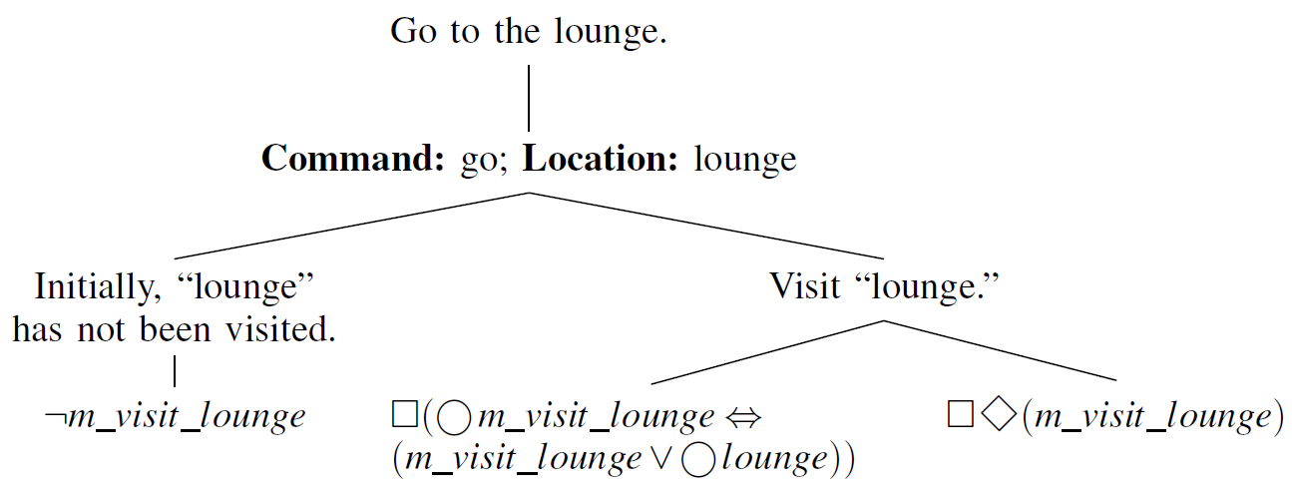

Sorry Dave, I’m Afraid I Can’t Do That: Explaining Unachievable Robot Tasks Using Natural Language
Sorry Dave, I’m Afraid I Can’t Do That: Explaining Unachievable Robot Tasks Using Natural Language
Sorry Dave, I’m Afraid I Can’t Do That: Explaining Unachievable Robot Tasks Using Natural Language
Sorry Dave, I’m Afraid I Can’t Do That: Explaining Unachievable Robot Tasks Using Natural Language
Vasumathi Raman, Constantine Lignos, Cameron Finucane, Kenton C.T. Lee, Mitch Marcus and Hadas Kress-Gazit
Automatically generate provably correct control from high-level specifications for robots from natural language instructions. Explain the cause of failure for unachievable specifications.
LTL Generation Macros
Generation Tree
Hierarchical explanation of how LTL formulas are generated from natural language.
Allows for natural language explanations of problems detected in the specification
Also allows the system to answer the question “What are you doing?”
LTL is generated by mapping each command to combinations of macros.
- goals
goal(x) generates
- persistent memories
memory(x) generates
- complete at least once
alo(x) generates
For example, patrolling a room is mapped to goal(room), and going to a room is mapped to alo(room)

Slide 4

Sorry Dave, I’m Afraid I Can’t Do That: Explaining Unachievable Robot Tasks Using Natural Language
Sorry Dave, I’m Afraid I Can’t Do That: Explaining Unachievable Robot Tasks Using Natural Language
Sorry Dave, I’m Afraid I Can’t Do That: Explaining Unachievable Robot Tasks Using Natural Language
Vasumathi Raman, Constantine Lignos, Cameron Finucane, Kenton C.T. Lee, Mitch Marcus and Hadas Kress-Gazit
Automatically generate provably correct control from high-level specifications for robots from natural language instructions. Explain the cause of failure for unachievable specifications.
Linear Temporal Logic MissiOn Planning Toolkit (LTLMoP)
Synthesis
Provably correct controllers from LTL specifications
GR(1) formulas:
Yields an implementing automaton (when one exists)
Execution
Automaton is viewed as a hybrid controller, calling lower-level continuous controllers
Can be deployed on physical robots or in simulation
SLURP
Analysis
Highlight minimal unsynthesizable core of the spec
Provide explanation in natural language
Allow the user to play an interactive game

Slide 5
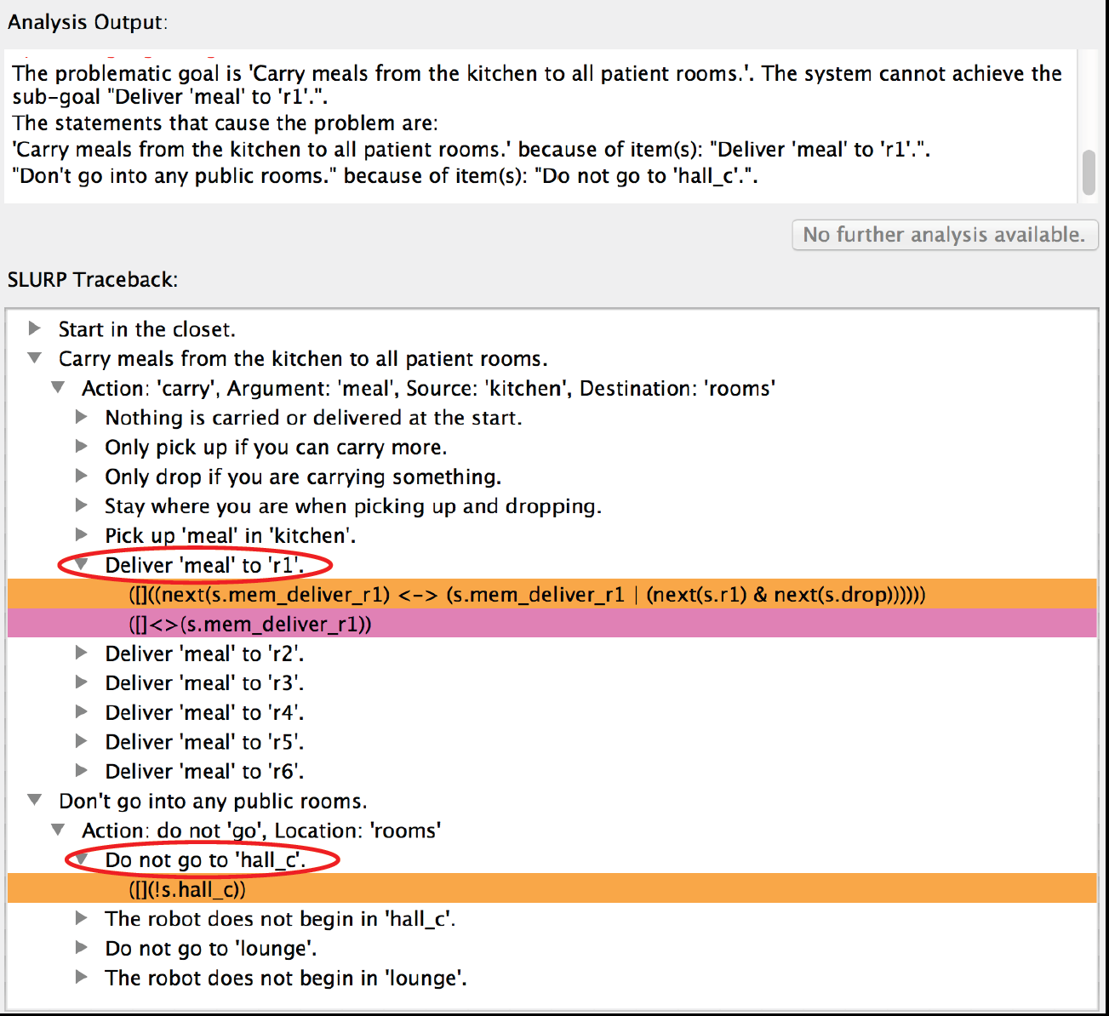
Sorry Dave, I’m Afraid I Can’t Do That: Explaining Unachievable Robot Tasks Using Natural Language
Sorry Dave, I’m Afraid I Can’t Do That: Explaining Unachievable Robot Tasks Using Natural Language
Sorry Dave, I’m Afraid I Can’t Do That: Explaining Unachievable Robot Tasks Using Natural Language
Sorry Dave, I’m Afraid I Can’t Do That: Explaining Unachievable Robot Tasks Using Natural Language
Vasumathi Raman, Constantine Lignos, Cameron Finucane, Kenton C.T. Lee, Mitch Marcus and Hadas Kress-Gazit
Automatically generate provably correct control from high-level specifications for robots from natural language instructions. Explain the cause of failure for unachievable specifications.
Core-Finding
Natural Language Feedback
Using the Generation Tree
Types of Unsynthesizability
Unsatisfiable: robot specification contains contradictory requirements
Unrealizable: there is an admissible environment that can prevent the robot from fulfilling the specified behaviour
Types of Failure
Deadlock: robot can be forced into a state where it has no legal moves
Livelock: robot stays trapped in a set of states that do not fulfill a goal
Start in the closet. Carry meals from the kitchen to all patient rooms. Don’t go into any public rooms.
Unsynthesizable Cores via SAT
- “Unroll” LTL specification to some depth
- Encode as a propositional SAT instance
- Use PicoSAT (solver) to find unsat core
- Core mapped back to the original specification

Slide 6
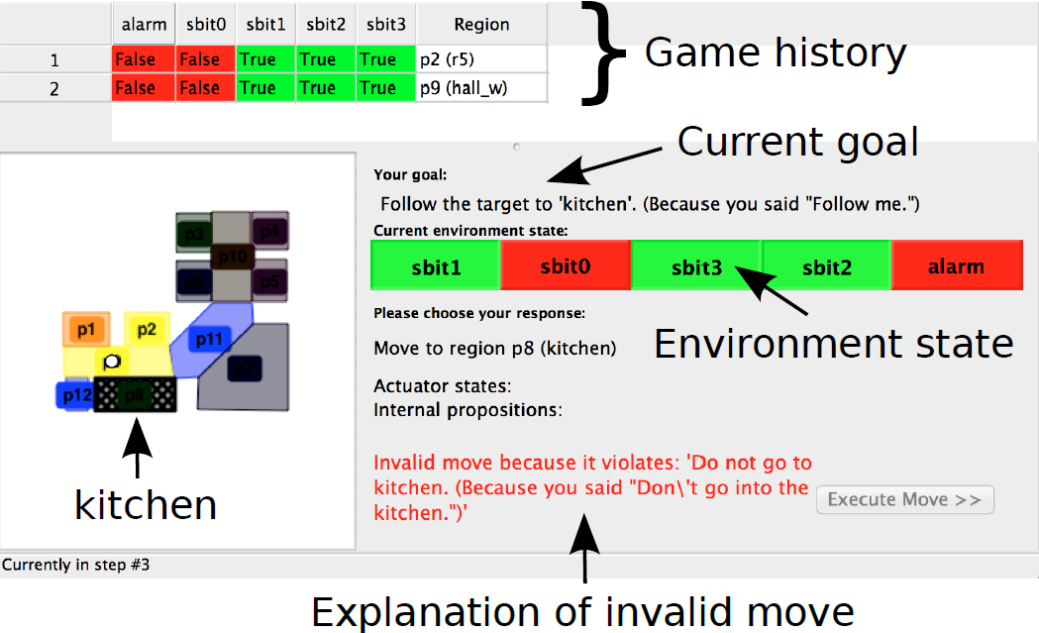
Sorry Dave, I’m Afraid I Can’t Do That: Explaining Unachievable Robot Tasks Using Natural Language
Sorry Dave, I’m Afraid I Can’t Do That: Explaining Unachievable Robot Tasks Using Natural Language
Sorry Dave, I’m Afraid I Can’t Do That: Explaining Unachievable Robot Tasks Using Natural Language
Sorry Dave, I’m Afraid I Can’t Do That: Explaining Unachievable Robot Tasks Using Natural Language
Vasumathi Raman, Constantine Lignos, Cameron Finucane, Kenton C.T. Lee, Mitch Marcus and Hadas Kress-Gazit
Automatically generate provably correct control from high-level specifications for robots from natural language instructions. Explain the cause of failure for unachievable specifications.
Interactive Game
Follow me.
Avoid the kitchen
Lets the user play as a robot against an adversarial environment
At each discrete time step, the tool presents the
current goal pursued and the current state of the environment.
The user is then able to change the location of the robot
and the states of its actuators in response.
A specific explanation is given about what part of the original specification is in conflict with any invalid moves.

Slide 7

Sorry Dave, I’m Afraid I Can’t Do That: Explaining Unachievable Robot Tasks Using Natural Language
Sorry Dave, I’m Afraid I Can’t Do That: Explaining Unachievable Robot Tasks Using Natural Language
Sorry Dave, I’m Afraid I Can’t Do That: Explaining Unachievable Robot Tasks Using Natural Language
Sorry Dave, I’m Afraid I Can’t Do That: Explaining Unachievable Robot Tasks Using Natural Language
Vasumathi Raman, Constantine Lignos, Cameron Finucane, Kenton C.T. Lee, Mitch Marcus and Hadas Kress-Gazit
Automatically generate provably correct control from high-level specifications for robots from natural language instructions. Explain the cause of failure for unachievable specifications.

